Slide 1
M.Tech DSE Machine Learning
Dr. Monali Mavani
Source: “Introduction to Machine Learning, 2nd edition, Ethem Alpaydin , “Machine Learning”, Tom M. Mitchell, Slides of Prof. Chetana from BITS Pilani
and many others who made their course materials freely available online.

Slide 2
Course Introduction
Objective of course
Introduction to the basic concepts and techniques of Machine Learning
Gain experience of doing independent study and research in the field of Machine Learning
Develop skills of using recent machine learning software tools to evaluate learning algorithms and model selection for solving practical problems
Evaluation scheme
Quiz (10% - 3 quiz: best 2 of 3)
2 Assignments (20%)
Mid-semester exam (30%)
Comprehensive exam (40%)
Virtual labs
http://elearn.bits-pilani.ac.in
7 May 2022

Slide 3
What We’ll Cover in this Course

Slide 4
Books
Text books and Reference book(s)
T1 | Tom M. Mitchell: Machine Learning, The McGraw-Hill Companies
T2 | Christopher M. Bhishop: Pattern Recognition & Machine Learning, Springer
R1 | C.J.C. BURGES: A Tutorial on Support Vector Machines for Pattern Recognition, Kluwer Academic Publishers, Boston.
7 May 2022

Slide 5
Agenda
What is Machine Learning?
Application areas of Machine Learning
Why Machine Learning is important?
Design a Learning System
Issues in Machine Learning
Types of Machine Learning
Supervised Machine Learning
Model fit-selection-assessment

Slide 6
Traditional Programming
What is Machine Learning?
Computer
Data Program
Output
Machine Learning
Computer
Data Output
Program
Slide credit: Pedro Domingos

Slide 7
Machine Learning
Machine learning is a scientific discipline that explores the construction and study of algorithms that can learn from data.
Such algorithms operate by building a model based on inputs and using that to make predictions or decisions, rather than following only explicitly programmed instructions.

Slide 8
What is Machine Learning?
Definition by Tom Mitchell (1998):
"A computer program is said to learn from experience E with respect to some class of tasks T and performance measure P, if its performance at tasks in T, as measured by P, improves with experience E.” Example: playing checkers.
E = the experience of playing many games of checkers
T = the task of playing checkers.
P = the probability that the program will win the next game.

Slide 9
Example of Learning Problems
7 May 2022

Slide 10
A Checker Learning Problem
Task T: Playing Checkers
Performance Measure P: Percent of games won against opponents
Training Experience E: To be selected ==> Games Played against itself
7 May 2022

Slide 11
A handwriting recognition learning problem
Task T: recognizing and classifying handwritten words within images
Performance measure P: percent of words correctly classified
Training Experience E: a database of handwritten words with given classifications
7 May 2022

Slide 12
A robot driving learning problem
Task T: driving on public four-lane highways using vision sensors
Performance measure P: average distance travelled before an error (as judged by human)
Training experience E: a sequence of images and steering commands recorded while observing a human driver
7 May 2022

Slide 13
Why “Learn” ?
Machine learning is programming computers to optimize a performance criterion using example data or past experience.
There is no need to “learn” to calculate payroll
Learning is used when:
Human expertise does not exist (navigating on Mars),
Humans are unable to explain their expertise (speech recognition)
Models must be customized (personalized medicine)
Models are based on huge amounts of data (genomics)

Slide 14
Problems not to be solved using ML
Tasks in which humans are very effective
Tasks in which frequent human intervention is needed
Simple tasks which can be implemented using traditional programming paradigms
Situations where training data is not sufficient

Slide 15
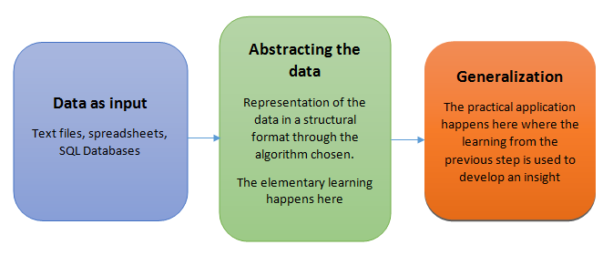
Machine Learning steps
Collecting data
Preparing the data
Training a model : Representation of data in the form of the model. Build a model that is a good and useful approximation to the data
Evaluating the model
Improving the performance : Learning

Slide 16
Application Domains
Web search
Computational biology
Finance
E-commerce
Space exploration
Robotics
Information extraction
Social networks
Language Processing
Many more emerging…
Slide credit: Pedro Domingos

Slide 17
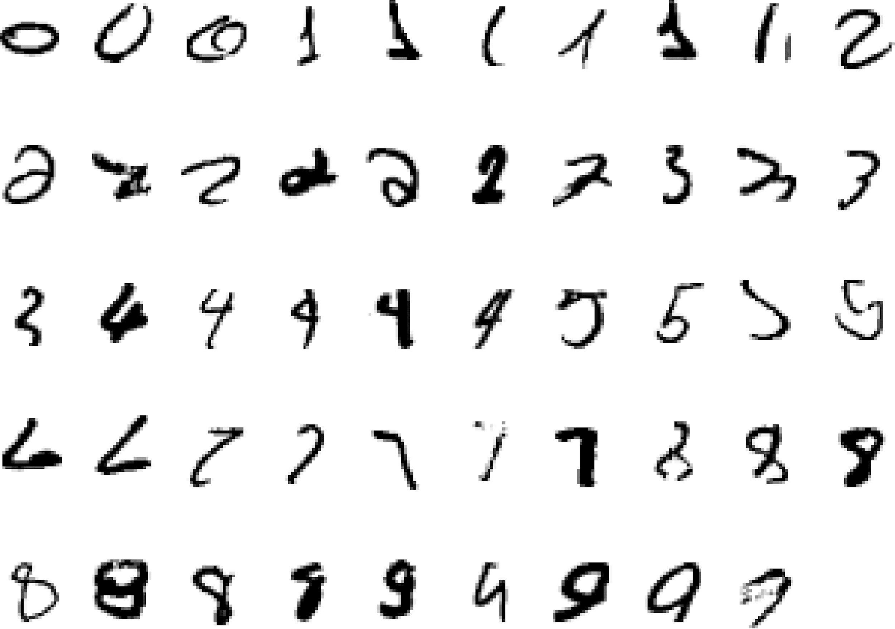
It is very hard to say what makes a 2
Pattern recognition
Slide credit: Geoffrey Hinton

Slide 18
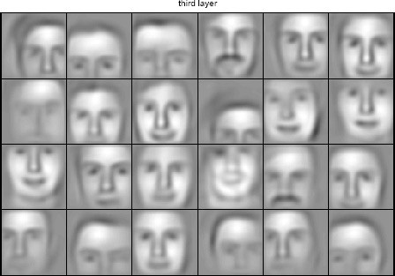
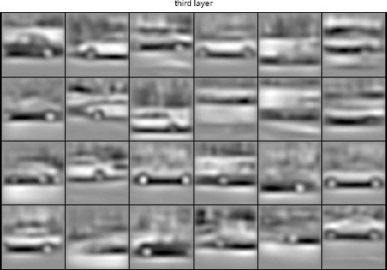
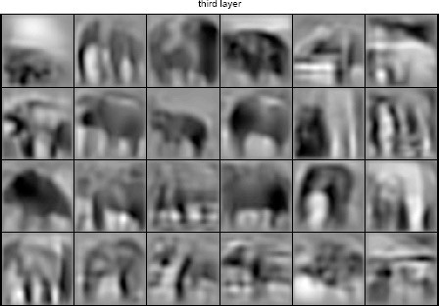
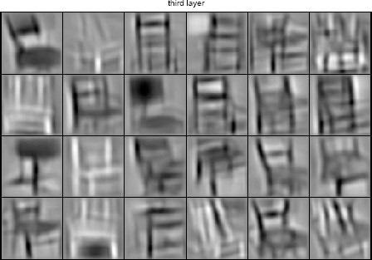
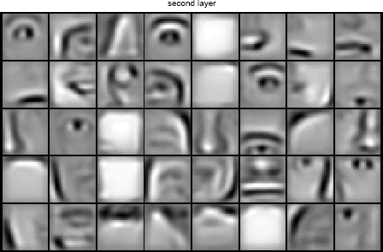
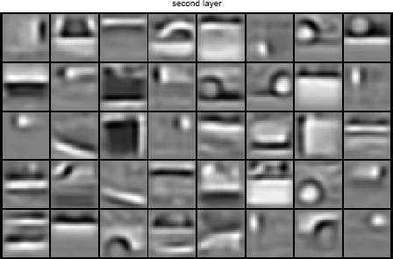
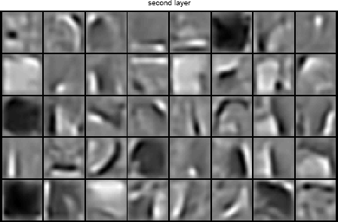
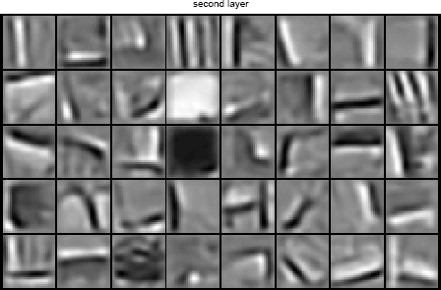
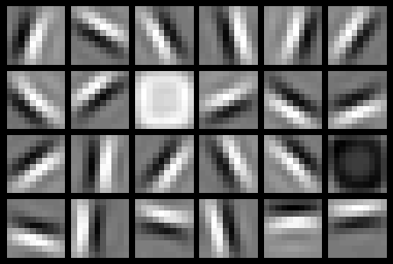
Learning of Object Parts
Slide credit: Andrew Ng

Slide 19
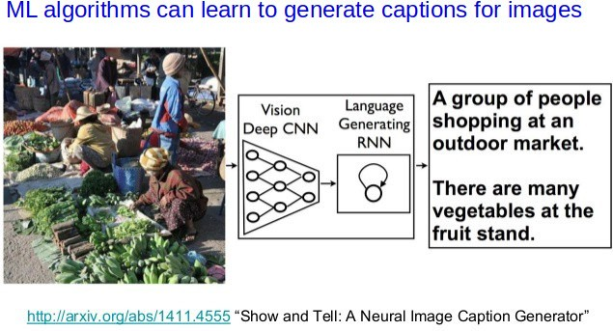
Image Captioning
Slide Credit: Piyush Rai

Slide 20
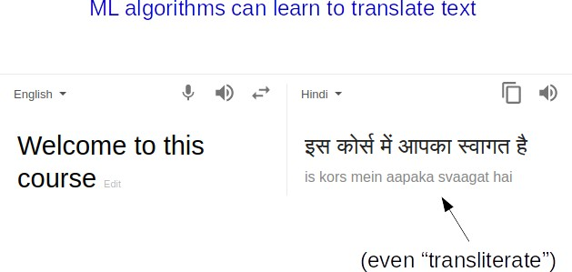
Natural Language Processing
Slide Credit: Piyush Rai

Slide 21
ML as a Learning System

Slide 22






Designing a Learning System
Choose the training experience(data)
Choose exactly what is to be learned
– i.e. the target function
Choose how to represent the target function
Choose a learning algorithm to infer the target function from the experience
Training data
Learner
Environment/ Experience
Knowledge
Testing data
Performance Element
Slide Credit: Ray Mooney

Slide 23
Designing a Learning System: An Example
1. Problem Description (Ex: Playing checkers)
2. Choosing the Training Experience (data expressed as features)
3. Choosing the Target Function to be learnt (Ex: deciding next board position
4. Choosing a Representation for the Target Function (design a function as linear etc)
5. Choosing a Function Approximation Algorithm (parameters learning using loss function)
6. Final Design
7 May 2022

Slide 25
Choosing the Training Experience
The type of training experience E available to a system can have significant impact on success or failure of the learning system.

Slide 26
Choosing the Training Experience
One key attribute is whether the training experience provides direct or indirect feedback regarding the choices made by the performance system

Slide 27
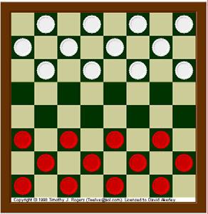
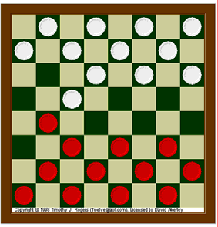
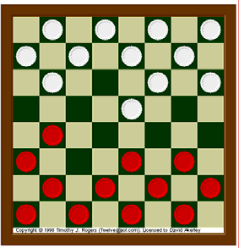
Direct Learning

Slide 28
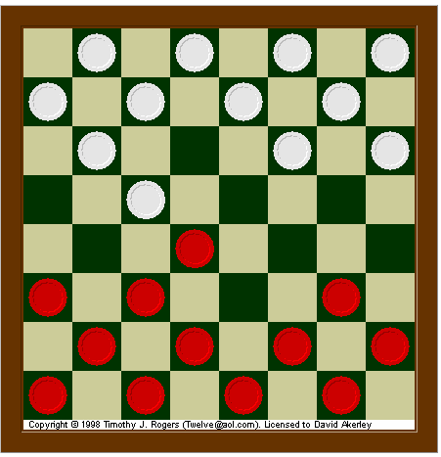
Indirect Learning
Next Move
Win / Loss

Slide 29
Choosing the training experience
In indirect training, information about the correctness of specific moves early in the game must be inferred indirectly from the fact that the game was eventually won or lost.
The learner faces an additional problem of credit assignment, or determining the degree to which each move in the sequence deserves credit or blame for the final outcome.
Credit assignment can be a particularly difficult problem because the game can be lost even when early moves are optimal, if these are followed later by poor moves. Hence, learning from direct training feedback is typically easier than learning from indirect feedback.
7 May 2022

Slide 30
Choosing the training experience -
How well the training experience represents the distribution of examples over which the final system performance P must be measured.
(Learning will be most reliable when the training example follow a distribution similar to that of future test examples)
E.G - the performance metric P is the percent of games the system wins in the world tournament. If its training experience E consists only of games played against itself, there is an obvious danger that this training experience might not be fully representative of the distribution of situations over which it will later be tested.

Slide 31
Assumptions
Let us assume that our system will train by playing games against itself.
And it is allowed to generate as much training data as time permits.

Slide 32

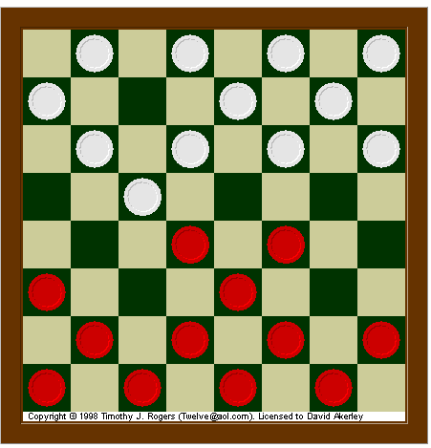
Main objective of the checker playing
Best Next Move

Slide 33
Target Function
Choose Move: B → M
Choose Move is a function
where input B is the set of legal board states and produces M which is the set of legal moves

Slide 34
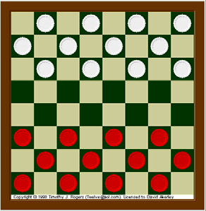
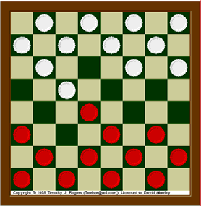
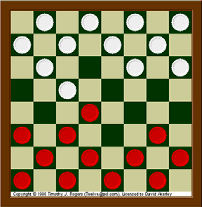
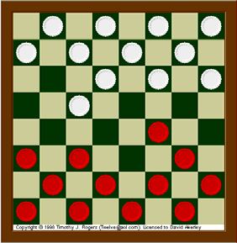
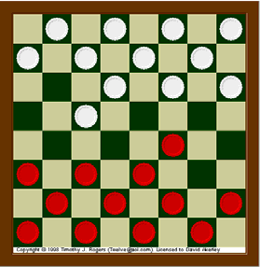
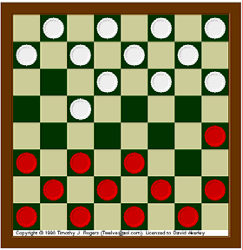
Input: Board State
Output: M (Moves)

Slide 35
Target Function
Choose Move: B → M
M = Choose Move (B)
ChooseMove, is difficult to learn directly.

Slide 36
Alternative Target Function
V : B → R
V is the target function,
Input B is the board state and
Output R denotes a set of real number
An easier and related target function to learn is function V: B --> R, which assigns a numerical score to each board. The better the board positions B, the higher the score R.

Slide 37
Input: Board State
Output: M (Moves)
V = 10
V= 7.7
V = 14.3
V = 10
V = 10.8
V = 6.3
V = 9.4

Slide 38
Choosing the Target Function
Let us therefore define the target value V(b) for an arbitrary board state b in B, as follows:
If b is a final board state that is won, then V(b) = 100
If b is a final board state that is lost, then V(b) = -100
If b is a final board state that is draw, then V(b) = 0
If b is a not a final state in the game, then V(b) = V(b’), where b' is the best final board state that can be achieved starting from b and playing optimally until the end of the game.
7 May 2022

Slide 39
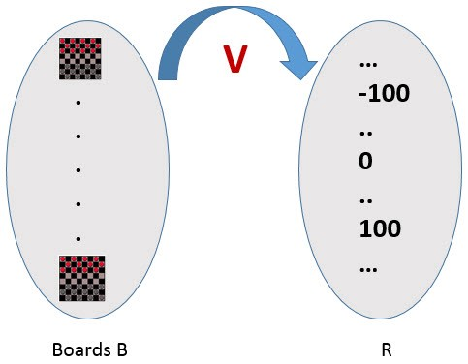
Choosing the Target Function

Slide 40
Choosing the Target Function
Reduced the learning task to the problem of discovering an operational description of the ideal target function V – it is difficult to learn V perfectly.
We often expect learning algorithms to acquire only some approximation to the target function -- is called function approximation. [The actual function can often not be learned and must be approximated]
7 May 2022

Slide 41
Choosing a Representation for the Target Function
Expressiveness versus Training set size
More expressive the representation of the target function, the closer to the “truth” we can get.
More expressive the representation, the more training examples are necessary to choose among the large number of “representable” possibilities.
Example of a representation:
x1 = # of red pieces on the board, x2 = # of black pieces on the board
X3= # of black king on the board
x4 = # of red king on the board
X5 = # of black pieces threatened by black
x6 = # of red pieces threatened by black
V(b) = w0+w1.x1+w2.x2+w3.x3+w4.x4+w5.x5+w6.x6
^
wi’s are adjustable
or “learnable”
coefficients
7 May 2022

Slide 42
Choosing a Representation for the Target Function
Task T: playing checkers
Performance measure P: % of games won in the world tournament
Training experience E: games played against itself
Target function: V : Board → R
Target function representation
V'(b) = w0 + w1x1+ w2x2 + w3x3 + w4x4 + w5x5 + w6x6
The problem of learning a checkers strategy reduces to the problem of learning values for the coefficients w0 through w6 in the target function representation

Slide 43
Choosing a Function Approximation Algorithm
Generating Training Examples of the form <b,Vtrain(b)> [e.g. <x1=3, x2=0, x3=1, x4=0, x5=0, x6=0, +100 (=blacks won)]
x1= # of black pieces on the board
x2 = # of red pieces on the board
x3 = # of black king on the board
x4 = # of red king on the board
x5 = # of black pieces threatened by red
x6 = # of red pieces threatened by black
30 August 2020

Slide 44
Types of Learning
Supervised (inductive) learning
Given: training data, desired outputs (labels)
Unsupervised learning
Given: training data (without desired outputs)
Semi-supervised learning
Given: training data + a few desired outputs
Reinforcement learning
Given: rewards from sequence of actions
Slide Credit: Eric Eaton

Slide 45


















Unsupervised Learning
Given x₁, x₂, ..., x_{n} (without labels)
Output hidden structure behind the x’s
– E.g., clustering
Slide Credit: Eric Eaton

Slide 46
A Typical Unupervised Learning Workflow (for Clustering)
Slide Credit: Piyush Rai

Slide 47
Reinforcement Learning
No predefined data
Allow an agent to take actions and interact with an environment so as to maximize the total rewards.
Examples:
Resources management in computer clusters
Game playing
Robot in a maze
Slide Credit: Eric Eaton

Slide 48
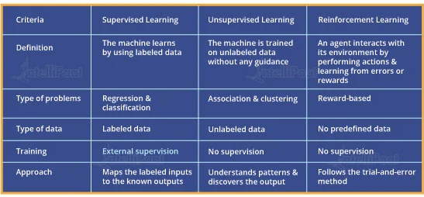
Supervised, Unsupervised and Reinforcement Learning Comparison

Slide 49
Supervised (inductive) learning

Slide 50
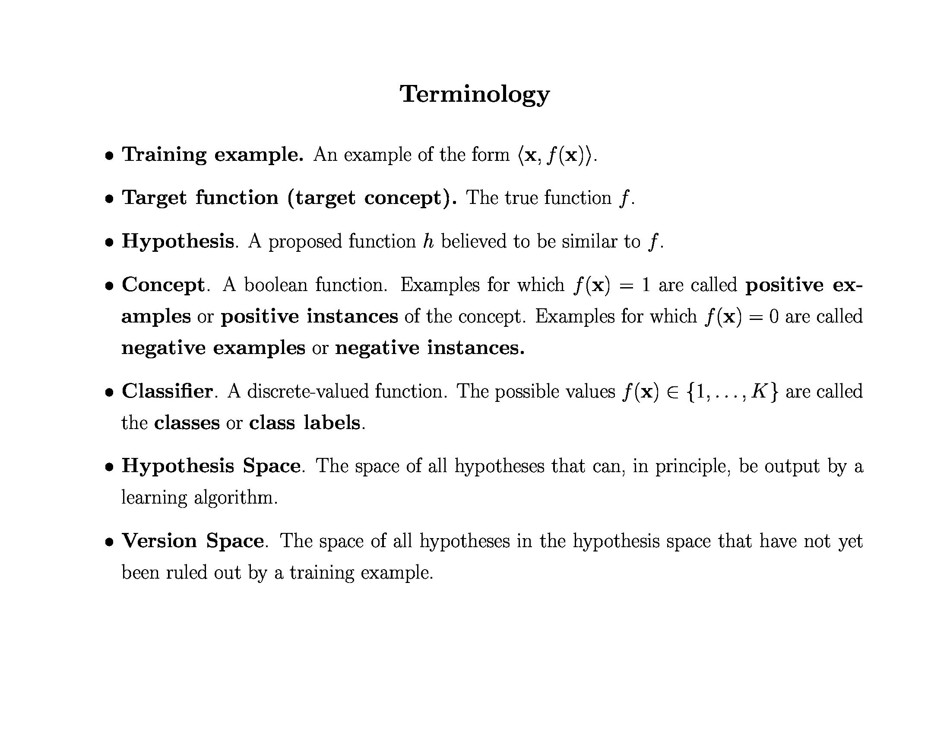

Slide 51
Inductive Learning Hypothesis
Any hypothesis found to approximate the target function well over a sufficiently large set of training examples will also approximate the target function well over other unobserved examples

Slide 52
Inductive Learning
Inductive learning or “Prediction”:
Given examples of a function (X, F(X))
Predict function F(X) for new examples X
Classification
F(X) = Discrete
Regression
F(X) = Continuous
Probability estimation
F(X) = Probability(X):

Slide 53
Learning a Class from Examples
Class C of a “family car”
Prediction: Is car x a family car?
Knowledge extraction: What do people expect from a family car?
Output:
Positive (+) and negative (–) examples
Input representation:
x₁: price, x₂ : engine power

Slide 54
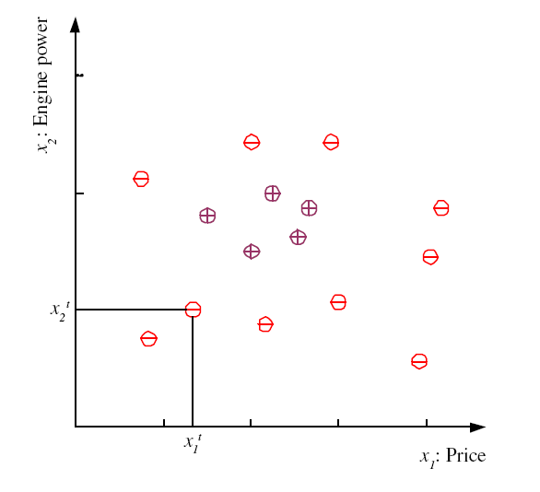
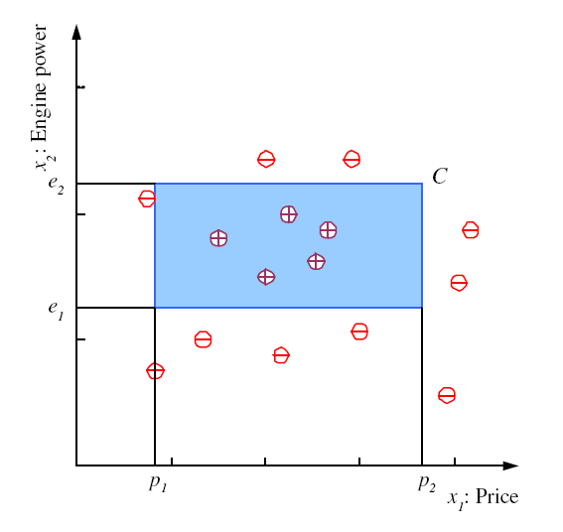
Training set X
Class C

Slide 55
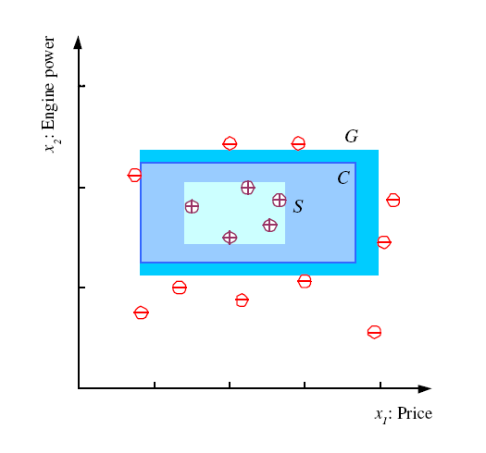
S, G, and the Version Space
most specific hypothesis, S
most general hypothesis, G
the hypothesis class H is the set of all possible rectangles.
h ∈ H, between S and G is consistent and make up the version space

Slide 56
Empirical Error
C = actual class
h = induced hypothesis.
false negative =>C is 1 but h is 0
false positive => C is 0 but h is 1

Slide 57
Noise
Imprecision in recording the
input attributes
Errors in labeling the data points
Additional hidden/latent attributes
that affect the label of an instance

Slide 58
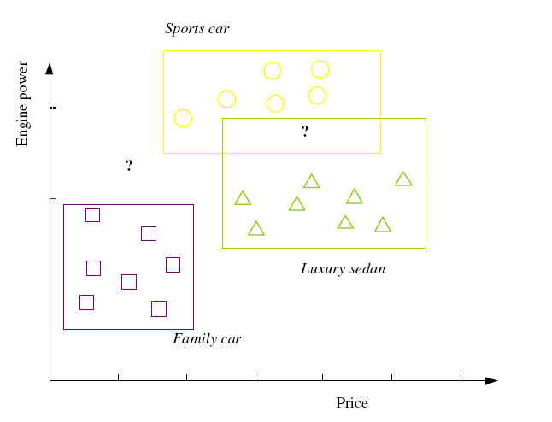
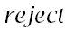
Multiple Classes, Ci i=1,...,K

Slide 59




Supervised Learning: Regression
Given (x₁, y₁), (x₂, y₂), ..., (x_{n}, y_{n})
Learn a function f(x) to predict y given x
9
8
7
6
5
4
3
2
1
0
1970 1980
September Arctic Sea Ice Extent (1,000,000 sq km)
1990
2000
2010
2020
Year
Data from G. Witt. Journal of Statistics Education, Volume 21, Number 1 (2013) Slide Credit: Eric Eaton

Slide 60
Regression
y = f(x)
Training: given a training set of labeled examples {(x₁,y₁), …, (x_{N},y_{N})}, estimate the prediction function f by minimizing the prediction error on the training set
Testing: apply f to a never before seen test example x and output the predicted value y = f(x)
output
prediction function
features
Slide credit: L. Lazebnik

Slide 61
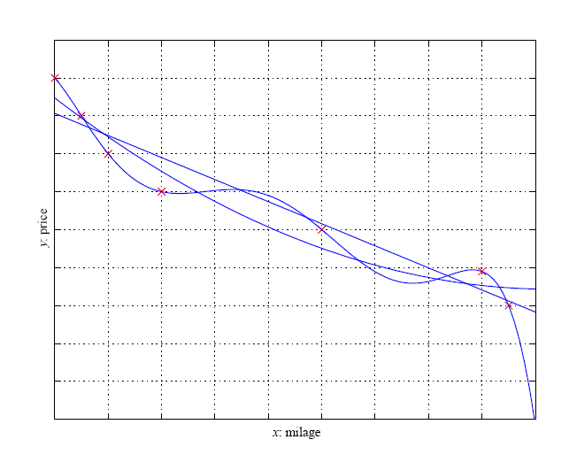
Regression

Slide 62
Inductive Bias
Learning is an ill-posed problem; data is not sufficient to find a unique solution
Need to make assumptions
Experience alone doesn’t allow us to make conclusions about unseen data instances
Inductive bias
The set of assumptions we make to have learning possible is called the inductive bias of the learning algorithm
The need for inductive bias, assumptions about H
Generalization—that is, how well our hypothesis will correctly classify future examples that are not part of the training set.

Slide 63
Training vs Testing
What do we want?
High accuracy on training data?
No, high accuracy on unseen/new/test data!
Why is this tricky?
Training data
Features (x) and labels (y) used to learn mapping f
Test data
Features used to make a prediction
Labels only used to see how well we’ve learned f!!!
Validation data
Held-out set of the training data
Can use both features and labels to tune parameters of the model we’re learning

Slide 64
Train-test error
Target variable Y , a vector of inputs X, and prediction model f(x)-hat that has been estimated from a training set T. The loss function for measuring errors between Y and f(X)-hat is L(Y, f(X)-hat). Typical choices are
Training error is the average loss over the training sample
Test error, also referred to as generalization error, is the prediction error over an independent test sample. the training set T is fixed, and test error refers to the error for this specific training set

Slide 65
Model selection and assessment
Model selection: estimating the performance of different models in order to choose the best one.
Model assessment: having chosen a final model, estimating its prediction error (generalization error) on new data.
To estimate generalization error (measure the quality of inductive bias), we need data unseen during training. We split the data as
Training set : used to fit the models;
Validation set : used to estimate prediction error for model selection, tune hyperparameters
Test (publication) set : is used for assessment of the generalization error of the final chosen model

Slide 66
Cross-Validation
Resampling when there is few data
cross-validation : choosing the hypothesis that is the most accurate on the validation set is the best one (the one that has the best inductive bias)
= the fitted function, computed with the kth part of the data removed
K = N , leave-one-out cross-validation

Slide 67
Cross-Validation
Example:
For the k=3 part, we fit the model to the other K −1 parts of the data, and calculate the prediction error of the fitted model when predicting the kth part of the data. We do this for k = 1, 2, . . . ,K and combine the K estimates of prediction error.
= set of models f(x, ) indexed by a tuning parameter, with
the kth part of the data removed.
final chosen model is f(x, α-hat),
which is used to fit to all the data

Slide 68
Training vs. Test Distribution
We generally assume that training and test examples are independently drawn from the same overall distribution of data
– We call this “i.i.d” which stands for “independent and identically distributed”
Slide credit: Ray Mooney

Slide 69
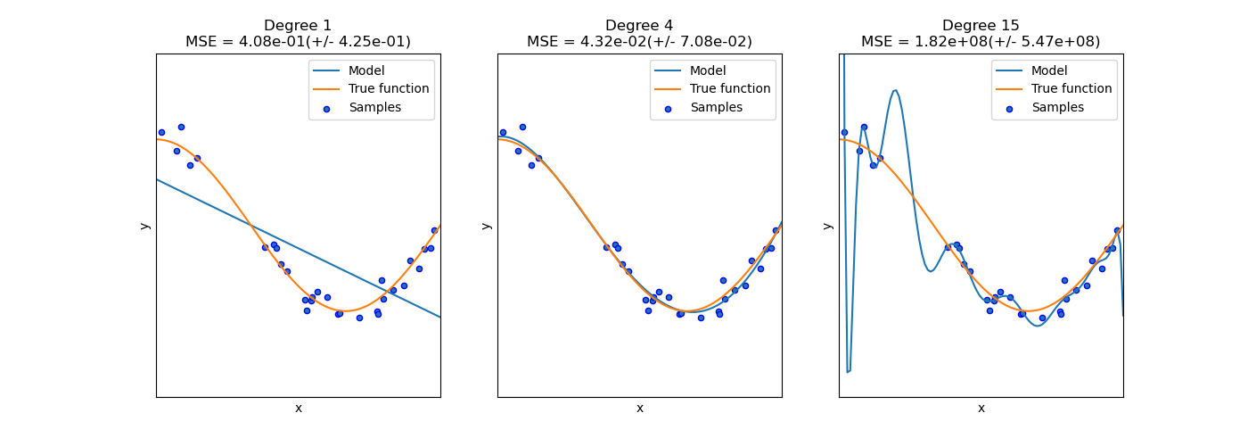
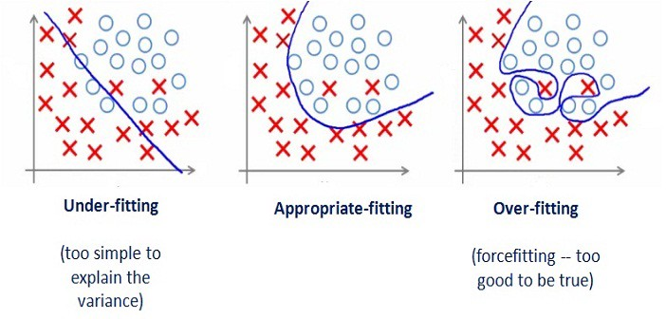
Overfitting/Underfitting

Slide 70
Triple Trade-Off
There is a trade-off between three factors (Dietterich, 2003):
Complexity of H, c (H),
Training set size, N,
Generalization error, E, on new data
As N increases, E↓
As c (H) increases, first E↓ and then E increases

Slide 71
Issues in Machine Learning
What algorithms are available for learning a concept? How well do they perform?
How much training data is sufficient to learn a concept with high confidence?
When is it useful to use prior knowledge?
Are some training examples more useful than others?
What are the best tasks for a system to learn?
What is the best way for a system to represent its knowledge?
7 May 2022

Slide 72
ML in a Nutshell
Tens of thousands of machine learning algorithms
Hundreds new every year
Every ML algorithm has three components
Representation
Optimization
Evaluation
Slide credit: Pedro Domingos

Slide 73


ML in Practice
Understand domain, prior knowledge, and goals
Data integration, selection, cleaning, pre-processing, etc.
Learn models
Interpret results
Consolidate and deploy discovered knowledge
Loop
Based on a slide by Pedro Domingos

Slide 74
Thank you !

